Slide 1
Bandwidth Utilization (Part 1): WDM and TDM
Course Code: COE 3201
Course Title: Data Communication
Dept. of Computer Engineering
Faculty of Engineering
Lecture No: | 8 | Week No: | 9 | Semester:
Lecturer:

Slide 2
Lecture Outline
Wavelength-division multiplexing (WDM)
Time-division multiplexing (TDM)
Synchronous TDM

Slide 3
Wavelength-division multiplexing (WDM)
Wavelength-division multiplexing (WDM) is designed to use the high-data-rate capability of fiber-optic cable.
The optical fiber data rate is higher than the data rate of metallic transmission cable but using a fiber-optic cable for a single line wastes the available bandwidth.
WDM allows us to combine several lines into one.

Slide 4
WDM is conceptually the same as FDM, except that the multiplexing and demultiplexing involve optical signals transmitted through fiber-optic channels.
The idea is the same: We are combining different signals of different frequencies.
The difference is that the frequencies are very high.
Figure 6.10 gives a conceptual view of a WDM multiplexer and demultiplexer.
Very narrow bands of light from different sources are combined to make a wider band of light. At the receiver, the signals are separated by the demultiplexer.

Slide 5
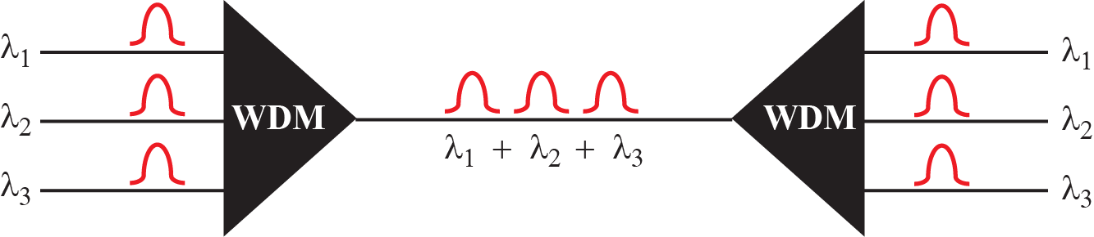
Figure 6.10: Wavelength-division multiplexing

Slide 6
Although WDM technology is very complex, the basic idea is very simple.
We want to combine multiple light sources into one single light at the multiplexer and do the reverse at the demultiplexer.
The combining and splitting of light sources are easily handled by a prism.

Slide 7
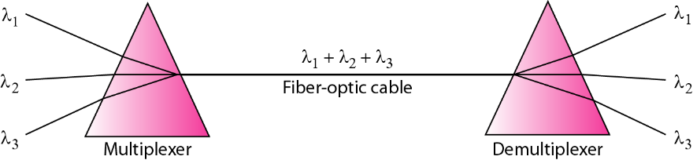
Figure 6.11: Prisms in wave-length division multiplexing

Slide 8
Time-division multiplexing (TDM)
Time-division multiplexing (TDM) is a digital process that allows several connections to share the high bandwidth of a link.
Instead of sharing a portion of the bandwidth as in FDM, time is shared. Each connection occupies a portion of time in the link.
Figure 6.12 gives a conceptual view of TDM.
Note that the same link is used as in FDM; here, however, the link is shown sectioned by time rather than by frequency.

Slide 9
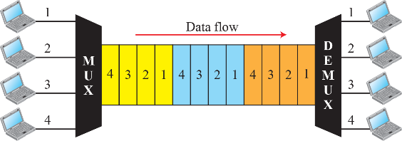
In the figure, portions of signals 1, 2, 3, and 4 occupy the link sequentially.
Figure 6.12: TDM

Slide 10
Synchronous TDM
We can divide TDM into two different schemes: synchronous and statistical.
In synchronous TDM, each input connection has an allotment in the output even if it is not sending data.
Time Slots and Frames: In synchronous TDM, the data flow of each input connection is divided into units, where each input occupies one input time slot. Each input unit becomes one output unit and occupies one output time slot. However, the duration of an output time slot is n times shorter than the duration of an input time slot.

Slide 11
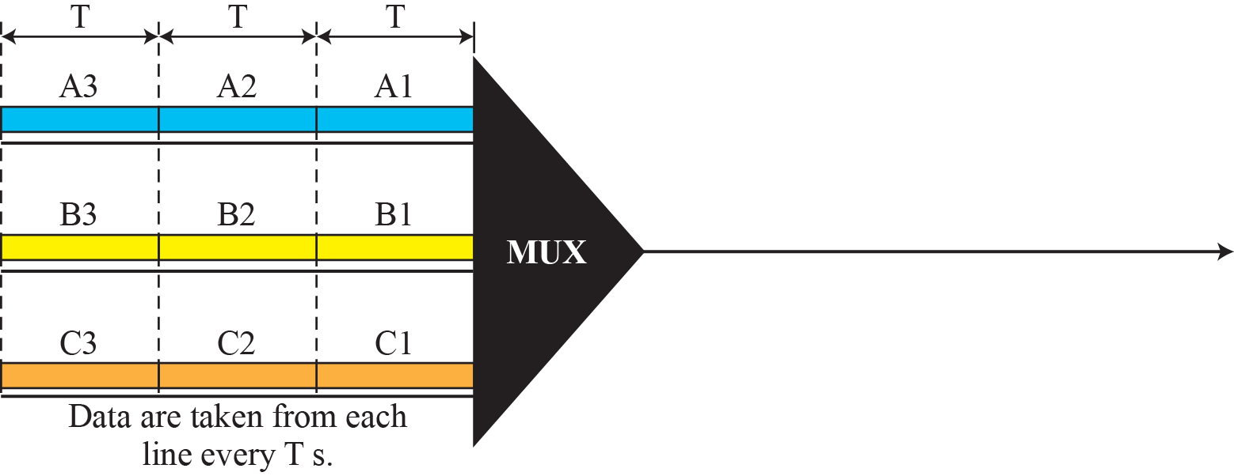
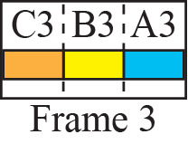
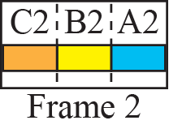
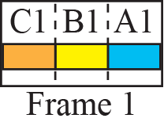
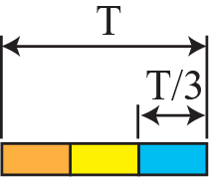

Synchronous TDM
Figure 6.13: Synchronous time-division multiplexing

Slide 12
Synchronous TDM
Example 6.5: In Figure 6.13, the data rate for each input connection is 1 kbps. If 1 bit at a time is multiplexed (a unit is 1 bit), what is the duration of 1. each input slot, 2. each output slot, and 3. each frame?
Solution: We can answer the questions as follows:
1. The data rate of each input connection is 1 kbps. This means that the bit duration is 1/1000 s or 1 ms. The duration of the input time slot is 1 ms (same as bit duration).
2. The duration of each output time slot is one-third of the input time slot. This means that the duration of the output time slot is 1/3 ms.
3. Each frame carries three output time slots. So the duration of a frame is 3 × (1/3) ms, or 1 ms. The duration of a frame is the same as the duration of an input unit.

Slide 13
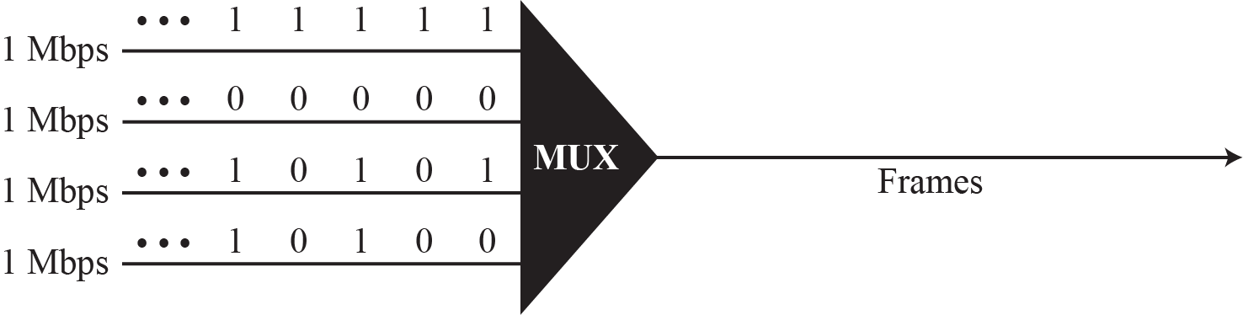
Synchronous TDM
Example 6.5: Figure 6.14 shows synchronous TDM with a data stream for each input and one data stream for the output. The unit of data is 1 bit. Find (a) the input bit duration, (b) the output bit duration, (c) the output bit rate, and (d) the output frame rate.
Figure 6.14: Example 6.6

Slide 14
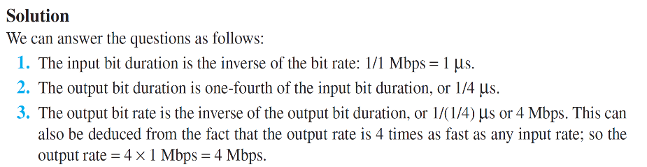
Synchronous TDM

Slide 15
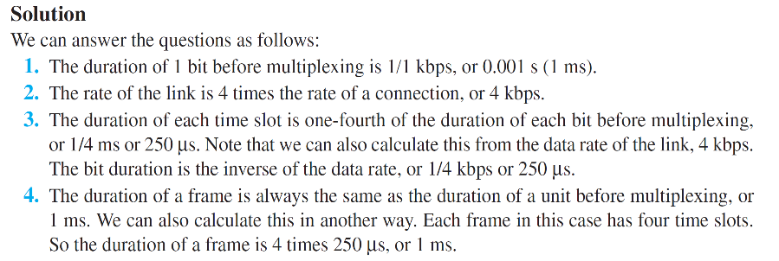
Synchronous TDM
Example 6.5: Four 1-kbps connections are multiplexed together. A unit is 1 bit. Find (1) the duration of 1 bit before multiplexing, (2) the transmission rate of the link, (3) the duration of a time slot, and (4) the duration of a frame.

Slide 16
Books
[1] Forouzan AB. Data communications & networking.
5th ed., Tata McGraw-Hill Education.

Slide 17
References
1. Prakash C. Gupta, “Data communications”, Prentice Hall India Pvt.
2. William Stallings, "Data and Computer Communications”, Pearson
3. Forouzan, B. A. "Data Communication and Networking. Tata McGraw." (2005).

